Slide 1


Hands-on Experiences on AI Implementation
Module 11: AI Implementation Process

Slide 2
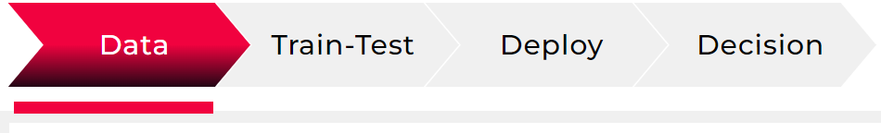
4 Simple Steps
Data Collection
& Pre-Process
Data Collection
Perform Preliminary Data Preprocessing
Get your 1st ML prediction result to have an overall assessment
Variable Selection or Feature Engineering
ML Model Selection
Parametric study
Finalizing the model
Build Model
Training-Testing
Production data collection
Production mode setting
Configuring, saving and distributing results
Result post processing for decision making
Deploy for
Production
Get Decision
Result Visualization
Scenario analysis for optimized decision

Slide 3


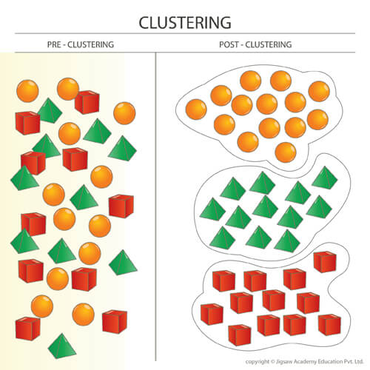
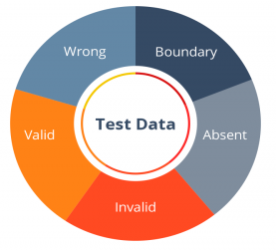

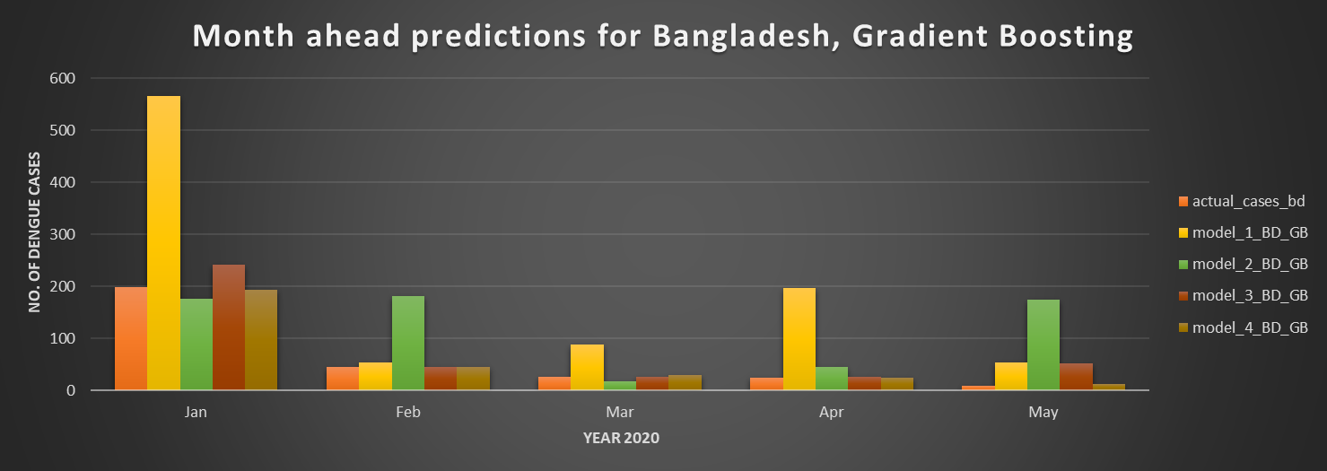





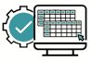

AI Implementation Process
Data
Training- Testing
Deploy
Decision
SME Driven Parametric Study
Insight
Brainstorming
Data
Data Preparation Cleanup
Data
Split
Feature
Engineering
ML Model Selection
Dengue
Prediction
New Variable Creation
Variable elimination
Anomaly Detection
Test Data
Before
After
Dengue Prediction
Hospital Patient
Missing Value
Replacement
1. Year Ahead
2. Month Ahead
3. Week Ahead
Machine Learning
Statistical Validation
Data
Ingestion
Training Data
BMD Weather
City Vector Survey
Tools:
In-house
idareAI
Validation Data
Model Deployment
Production
Modes
Decision
Parametric Study
Copyright@ IDARE

Slide 4
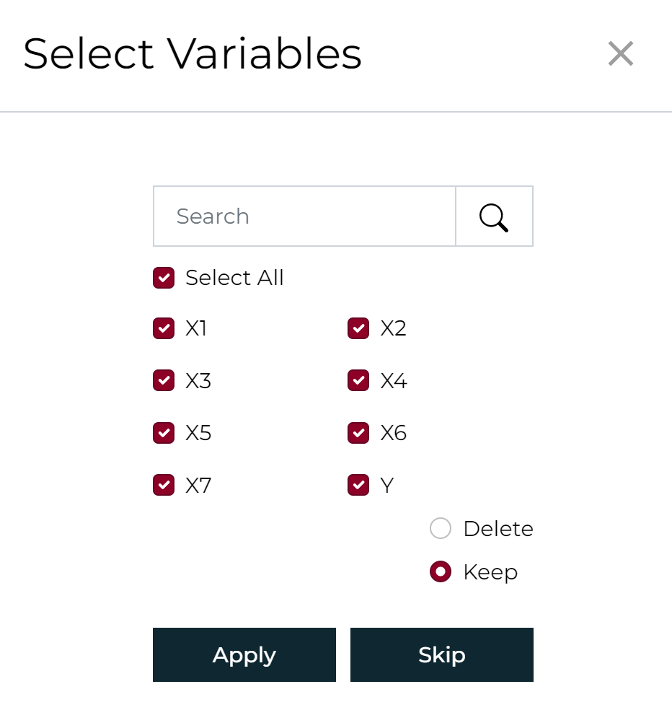
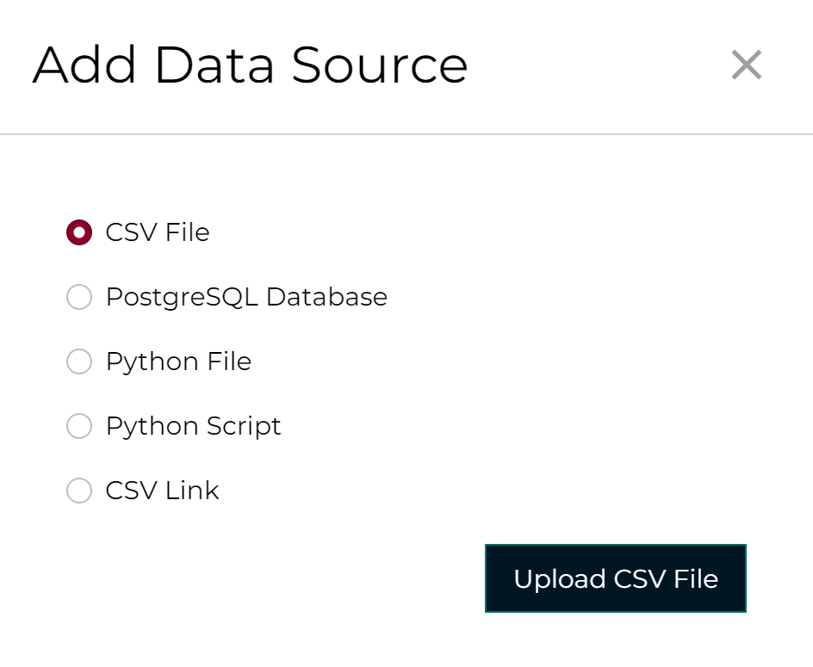
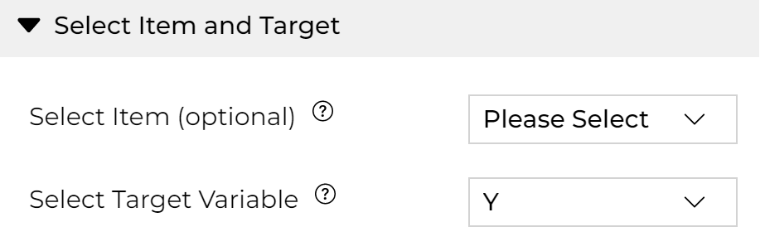
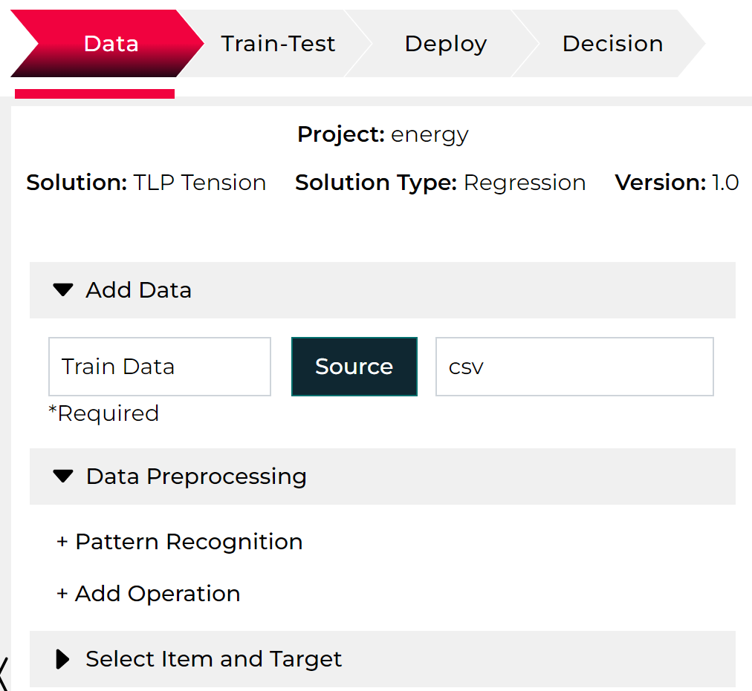
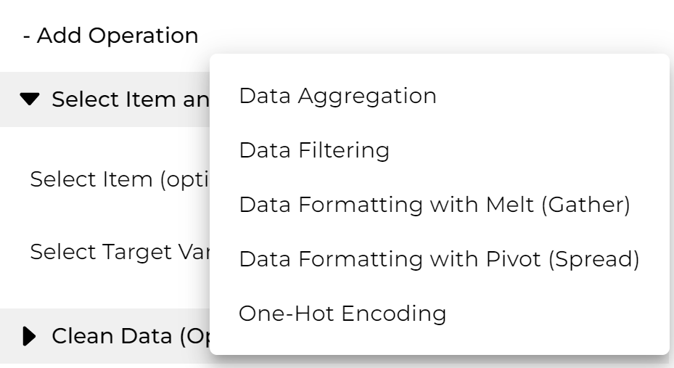
Data: Data Collection and Preprocess
Remove Unnecessary Variable
Read Data from your Sources
Select Item: if requires batch solution for different items i.e. location, assets, entity etc.
Select Target: Choose the column or variable that needs to be predicted
Train Test Split
Feature Data
Operate on Data

Slide 5
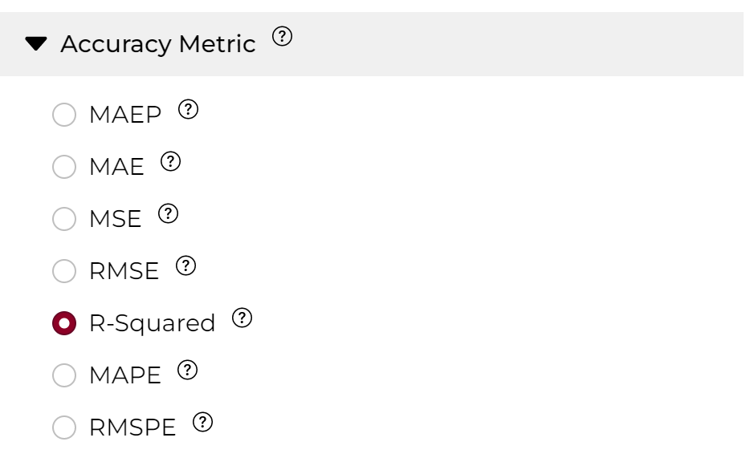
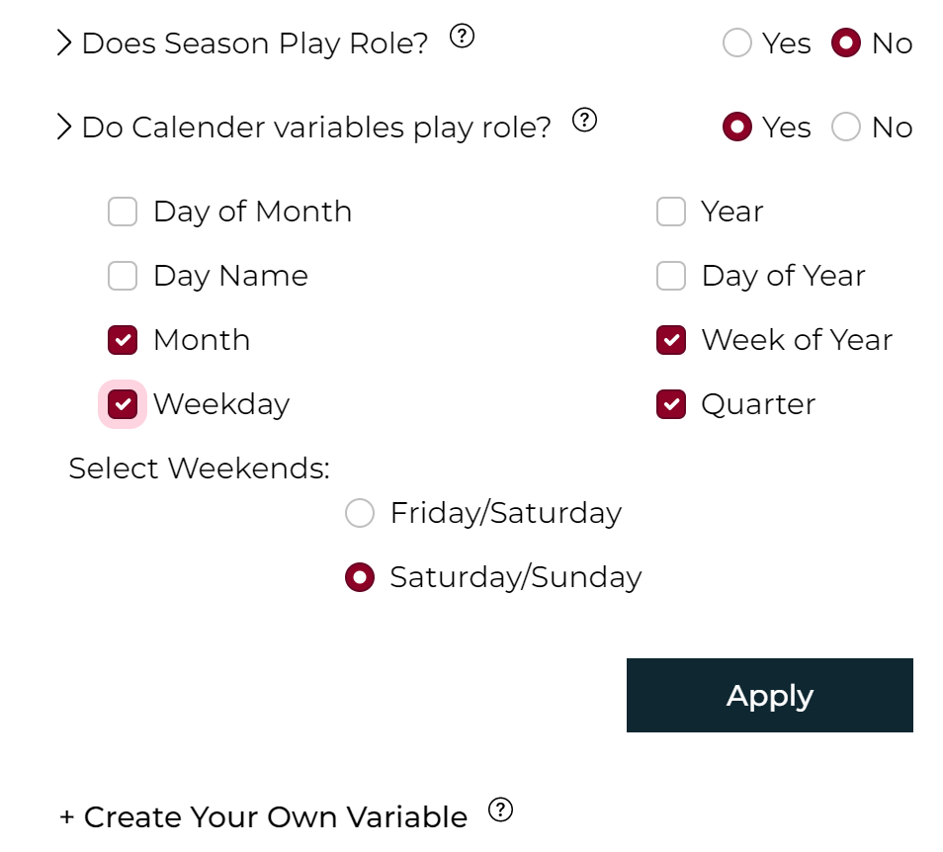
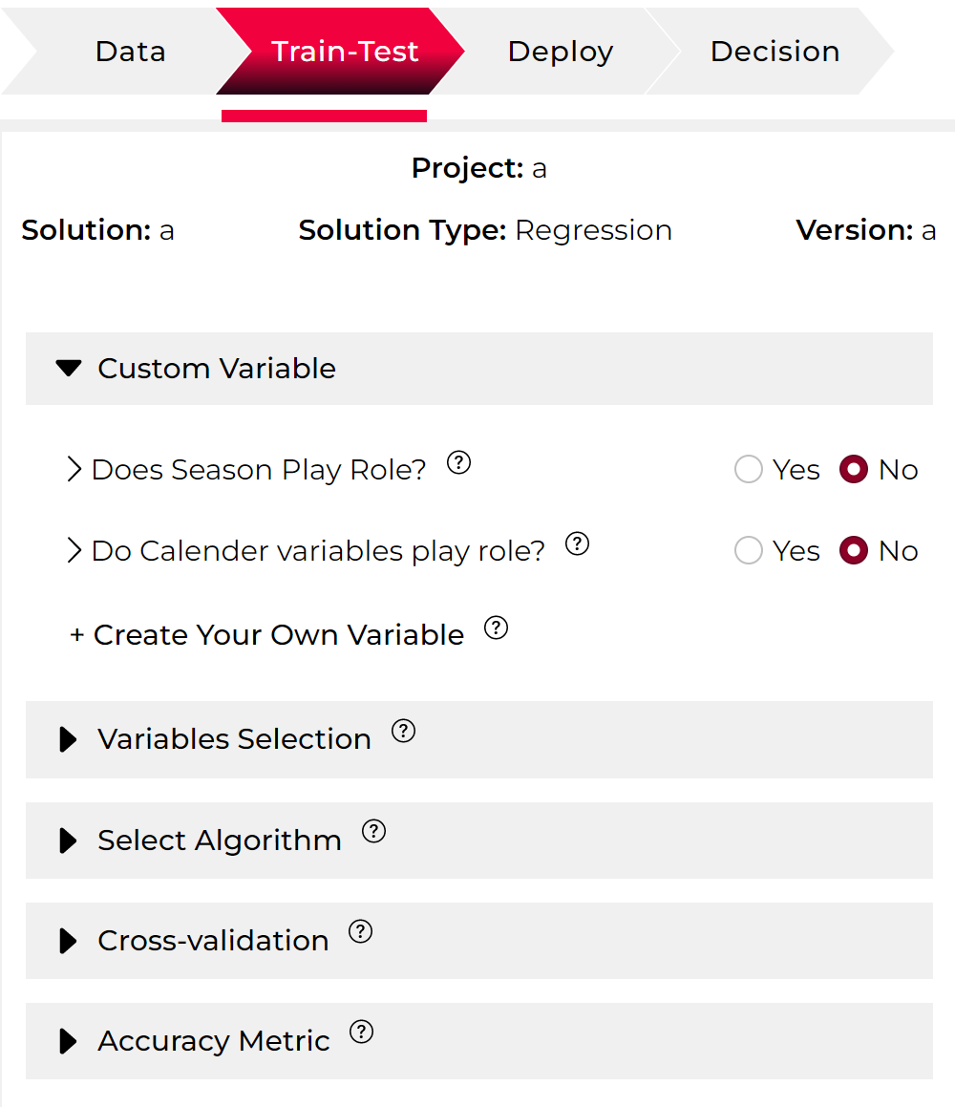
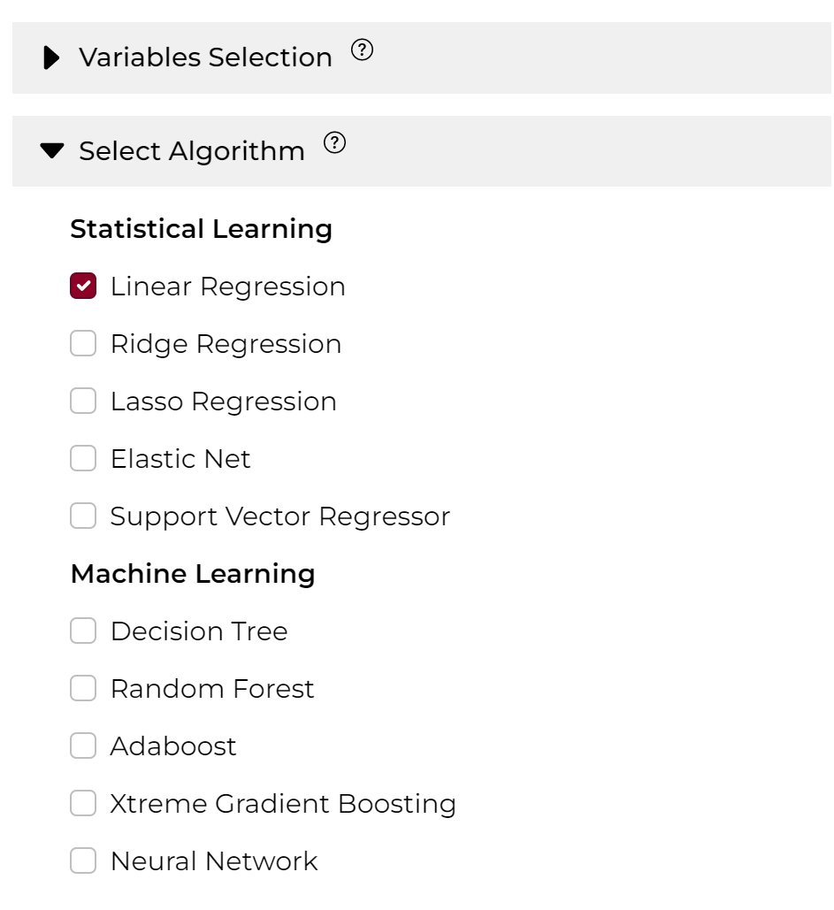
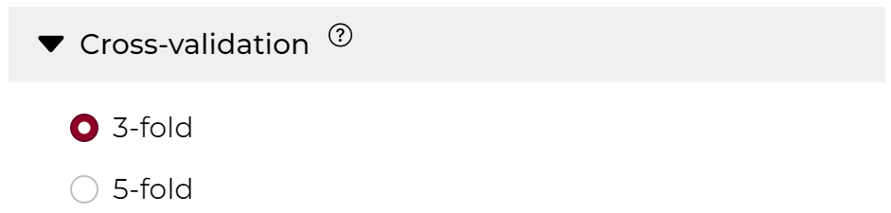

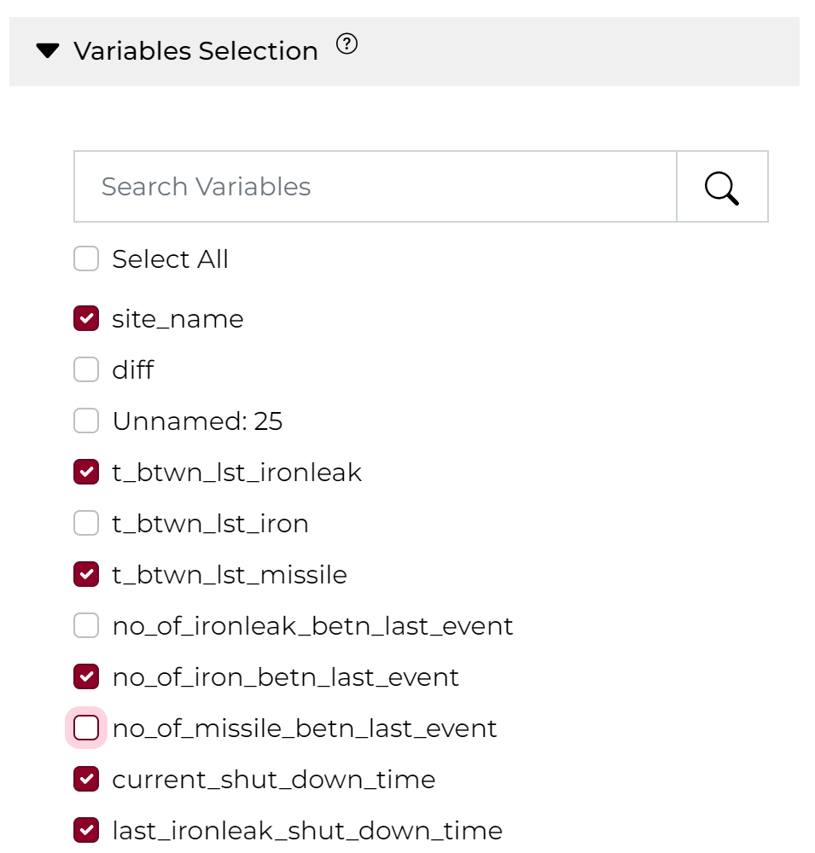
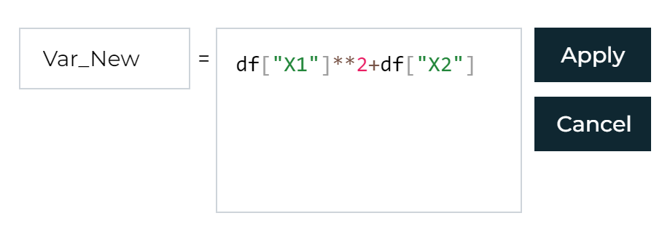
Model Building: Training Testing
Work on your Variable
Choose Algorithm
Choose Accuracy Metric
Validation
Finalize
Select Unselect Variable

Slide 6
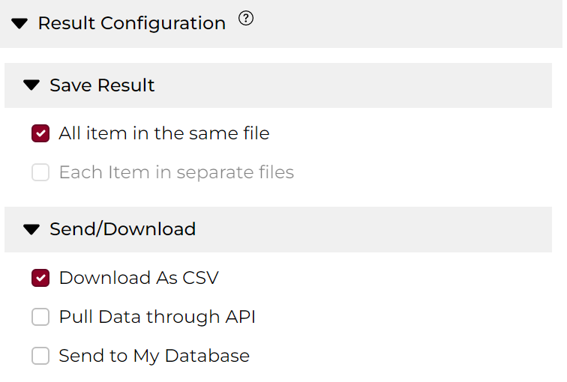
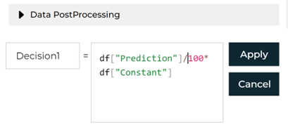
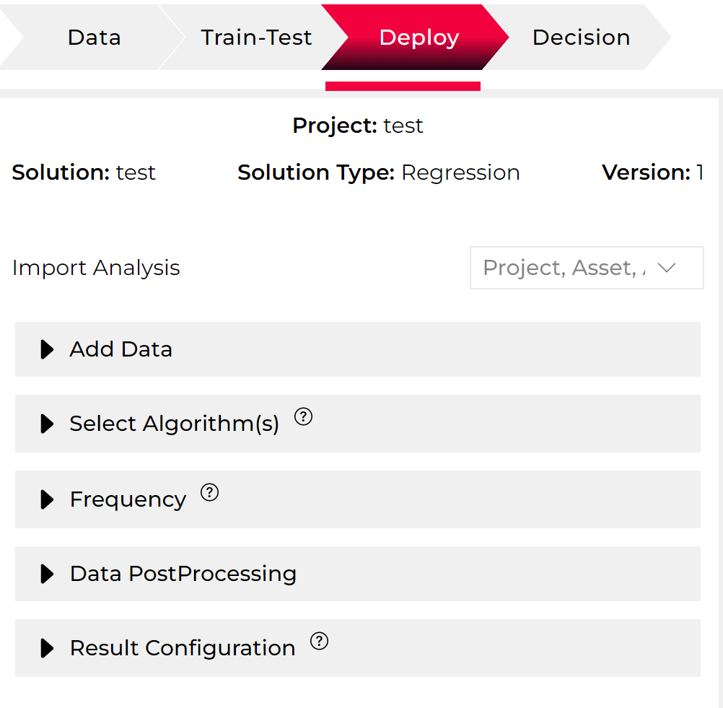
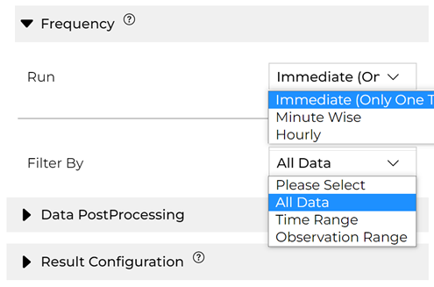
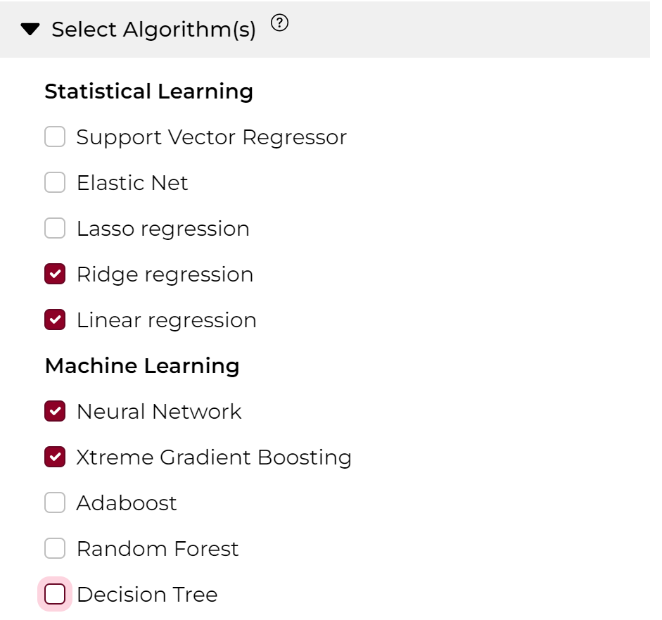
Deploy: Prediction in Production
Read
Production Data
Configure retrieval of result data
Create Decision Variable by Post-Processing Results
Perform all the data processing to create Feature Data
Predict
Set Production Mode
Frequency
Select Trained ML

Slide 7
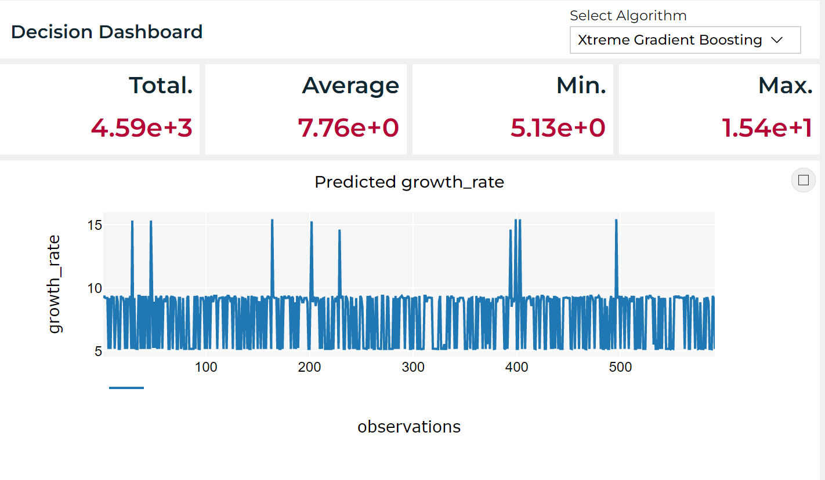
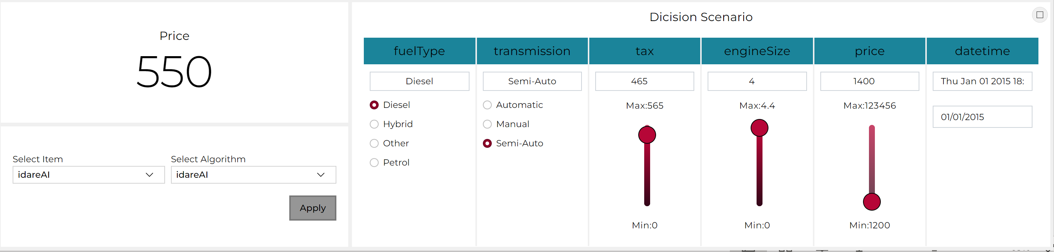
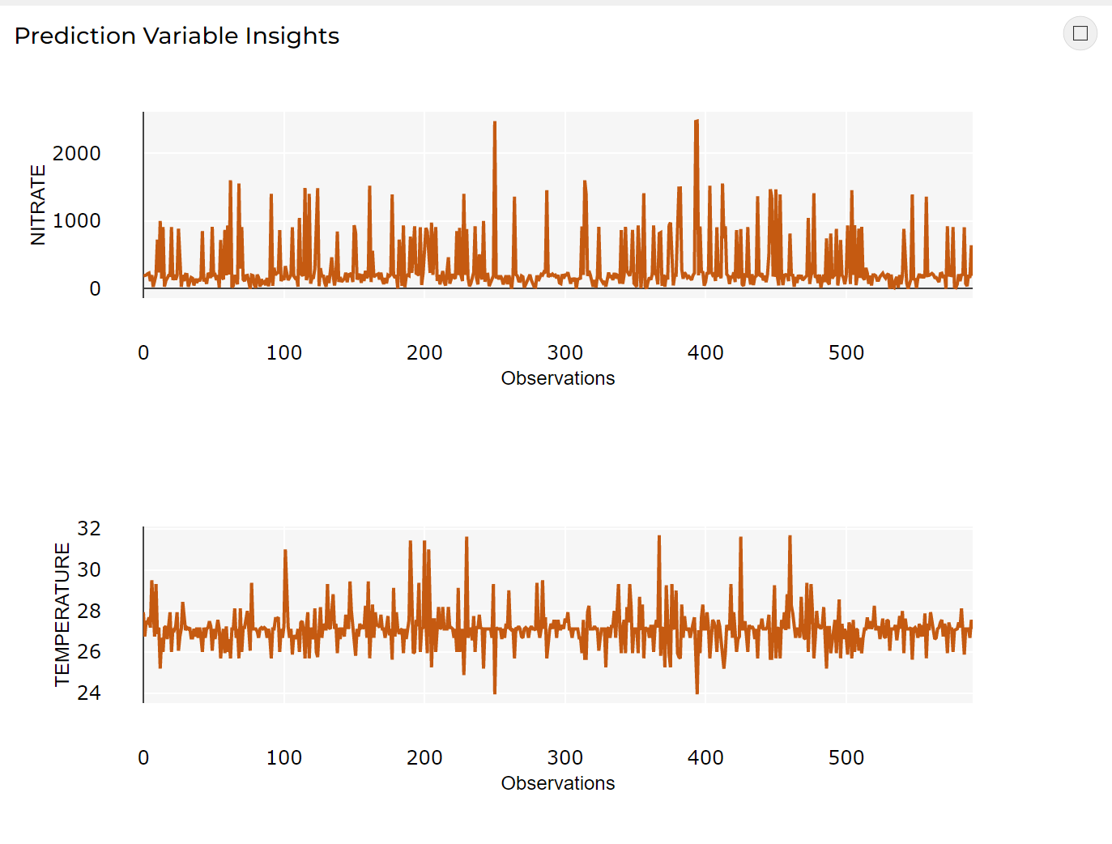


Decision
Visualize your Prediction Result
Obtain Different Decision scenario by what if analysis
Change different value of your production data to check what will be the prediction and associated decision variable
Visualize your data behind the Prediction

Slide 8
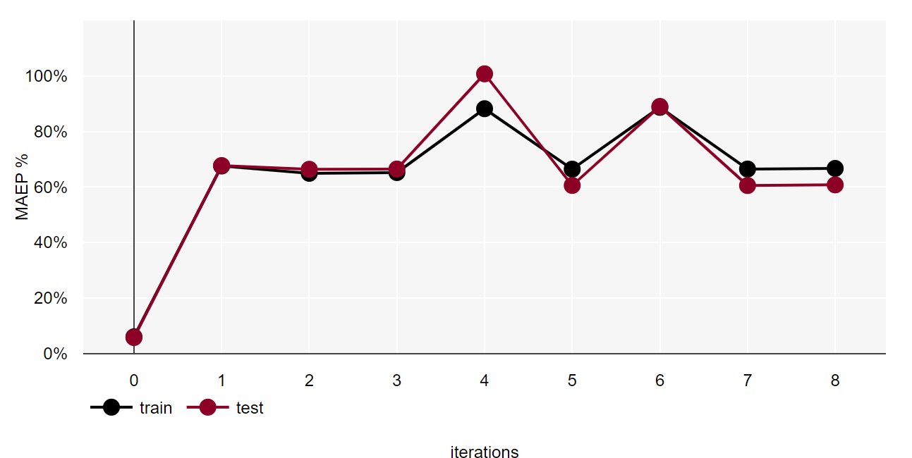
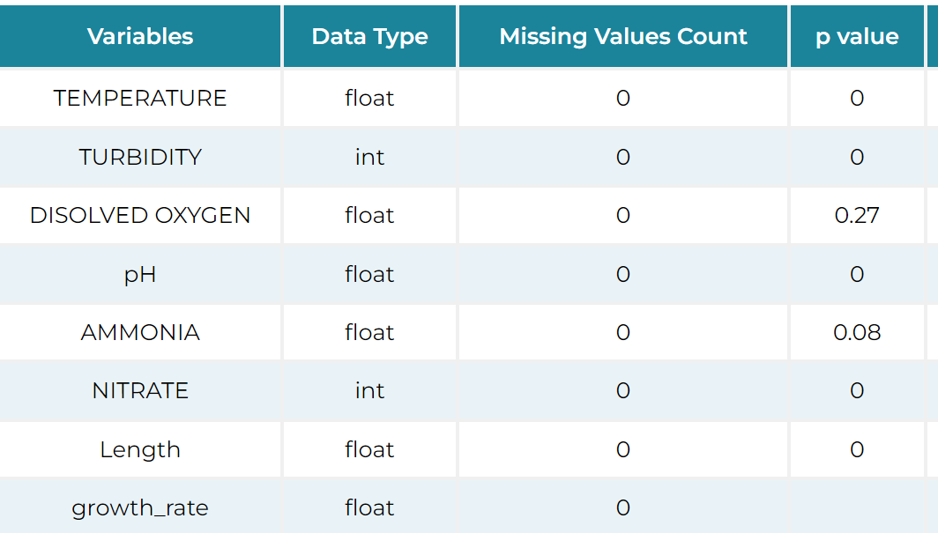
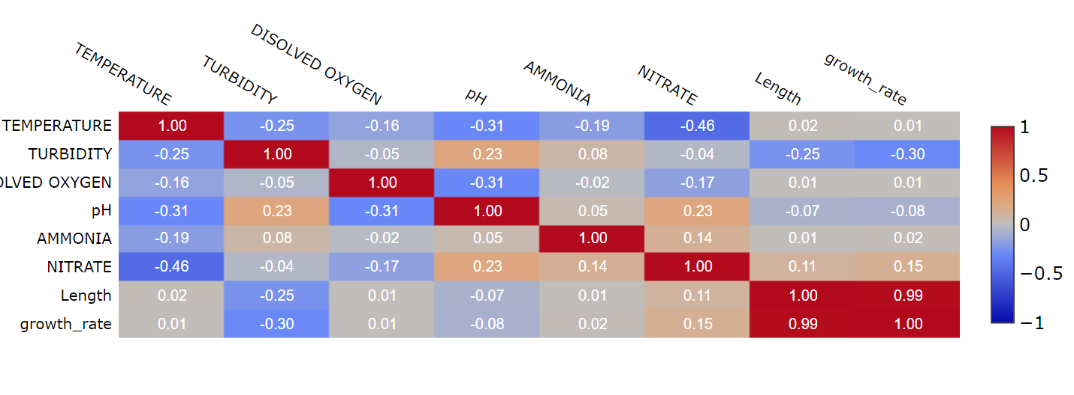
Successful Model Building: Variable/Feature Selection Strategy
Min. Error with
Min. Diff betwn Train-Test
Your target will be Lowest Error with Highest Stability with optimal bias and minimum variances.
Select the variable for
the lowest error AND
lowest differences between train and test error.
Train
Train
Train
Train
Start with the most important variables from your domain knowledge
1 ML Only
Add variables Pearson correlation coefficient w.r.t Target more than 0.5
Remove variable if a selected variables PCC w,r,t other variable > 0.3
Create Science Driven Variable
Add variables with p-value < 0.05
Add variable with p-value > 0.05 if needed
1
2
3
4
Repeat this process by many parametric study until reaching the desired accuracy

Slide 9


